Slide 1
Feature Scaling
Abhijit Ramesh Patil

Slide 2
What is Feature scaling ?
Feature scaling is one of the most important data pre-processing step in machine learning.
Feature scaling helps machine learning and deep learning algorithms to train and converge faster.
Feature scaling techniques are
1. Normalization
2. Standardization

Slide 3
In what type of algorithm we should apply feature scaling ?
The aim of this method is to scale the components of feature such that complete data has length one.
Any machine learning algorithm that computes the distance between the data points need feature scaling.
It makes training faster
Algorithms which require feature scaling
KNN (K Nearest Neighbours)
SVM (Support Vector Machine)
Logistic Regression
K means Clustering

Slide 4
What are different techniques of Feature Scaling ?
Feature scaling techniques:
1) Normalization
2) Standardization

Slide 5
Explain both techniques of Feature Scaling ?
Feature scaling techniques:
1) Normalization
2) Standardization

Slide 6
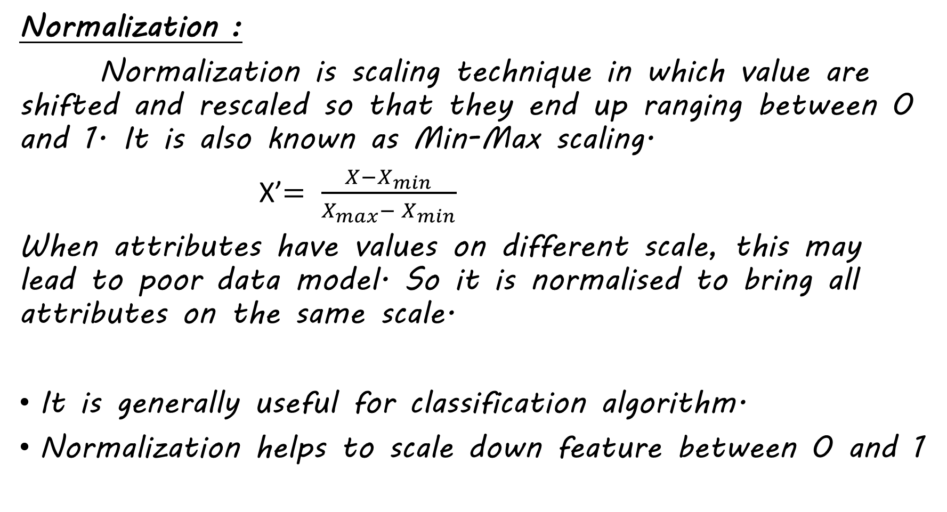
Normalization :
Normalization is scaling technique in which value are shifted and rescaled so that they end up ranging between 0 and 1. It is also known as Min-Max scaling.
X’$= \frac{X−X_{min}}{X_{max}− X_{min}}$
When attributes have values on different scale, this may lead to poor data model. So it is normalised to bring all attributes on the same scale.
It is generally useful for classification algorithm.
Normalization helps to scale down feature between 0 and 1

Slide 7
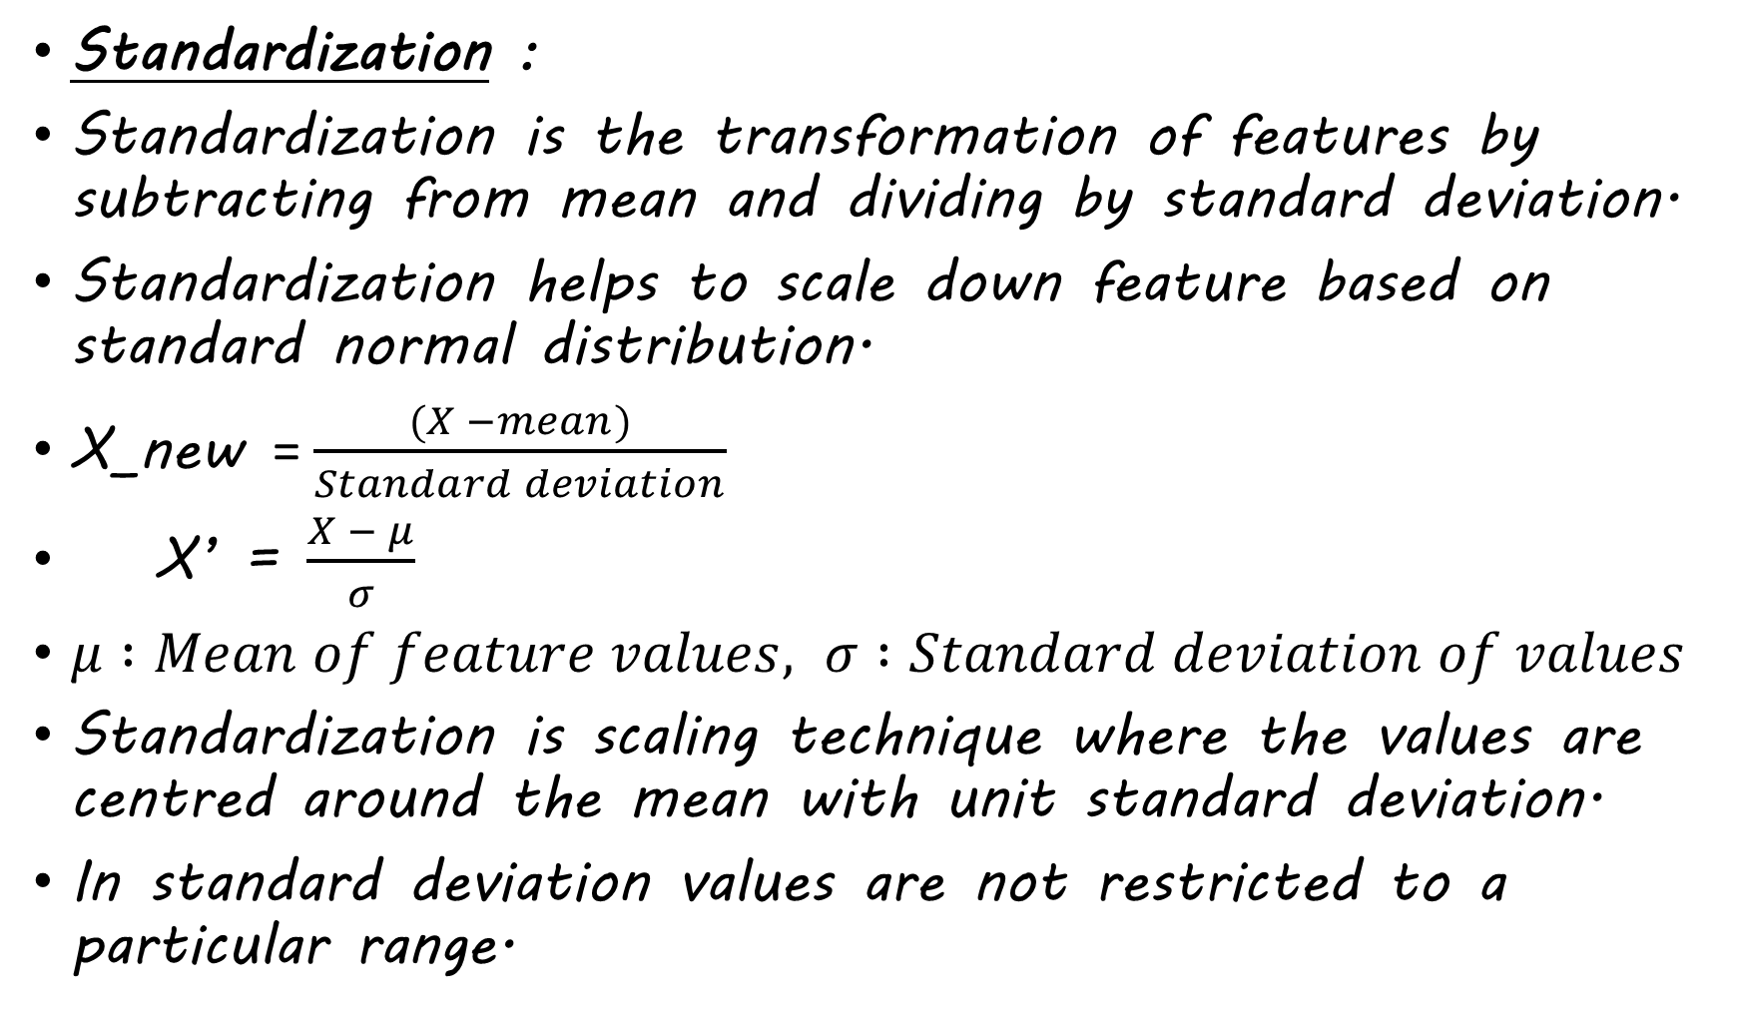
Standardization :
Standardization is the transformation of features by subtracting from mean and dividing by standard deviation.
Standardization helps to scale down feature based on standard normal distribution.
X_new = $\frac{(X −mean)}{Standard deviation}$
X’ = $\frac{X − μ}{σ}$
$μ :Mean of feature values, σ :Standard deviation of values$
Standardization is scaling technique where the values are centred around the mean with unit standard deviation.
In standard deviation values are not restricted to a particular range.

